Slide 1

Team Members:
1. Vishali 2. Divya 3. Kanaka Durga 4. Charishma 5. Pratyusha 6. Lahari

Slide 2


Slide 3
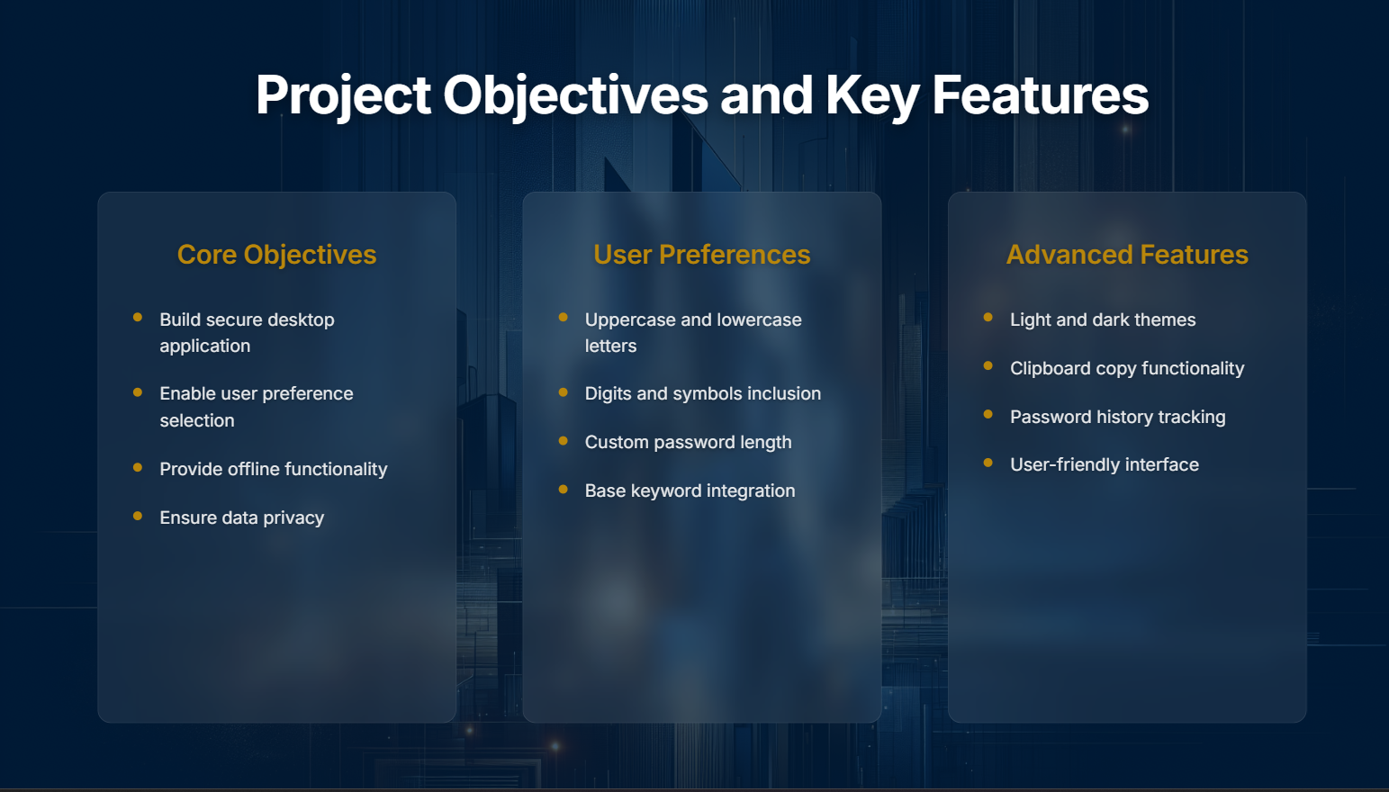

Slide 4


Slide 5


Slide 6


Slide 7
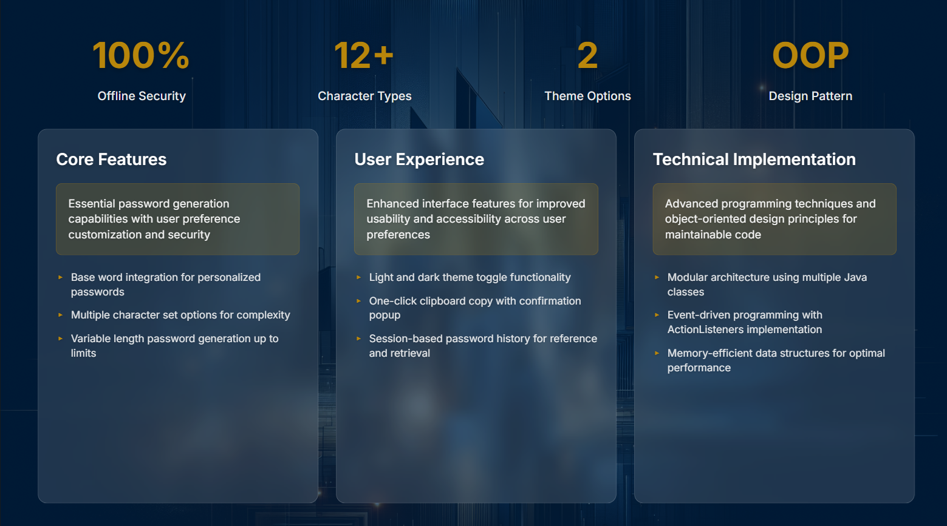

Slide 8
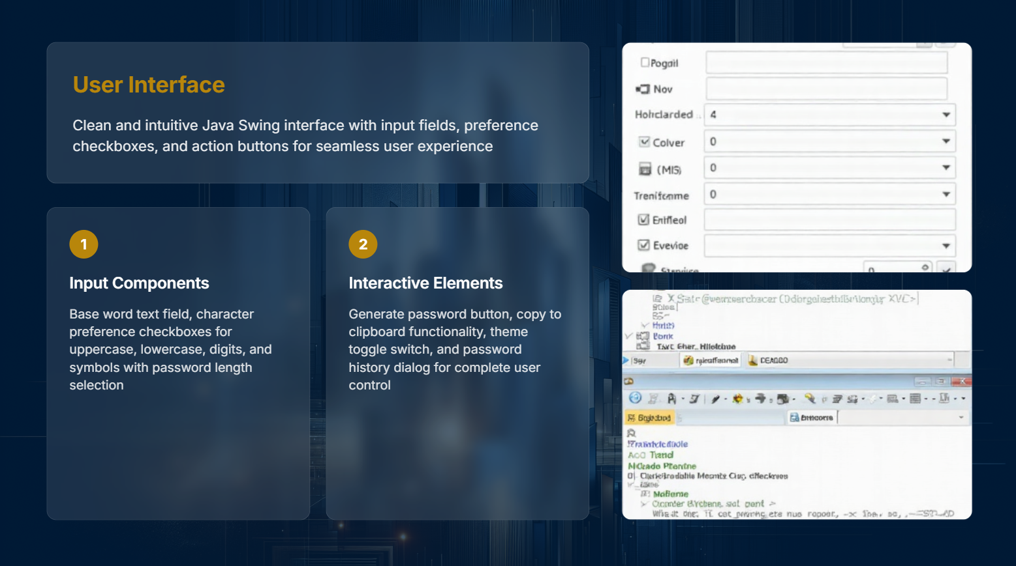
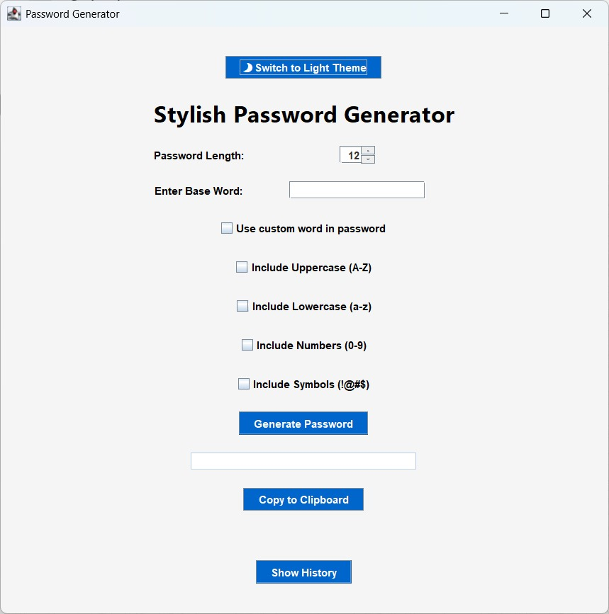

Slide 9
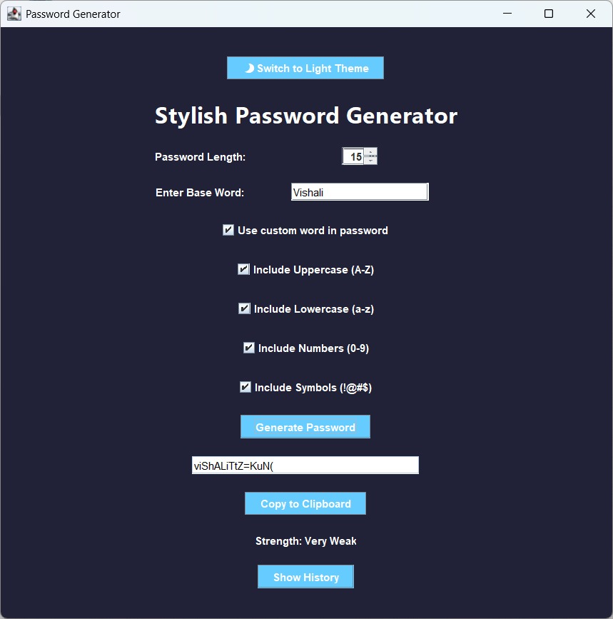
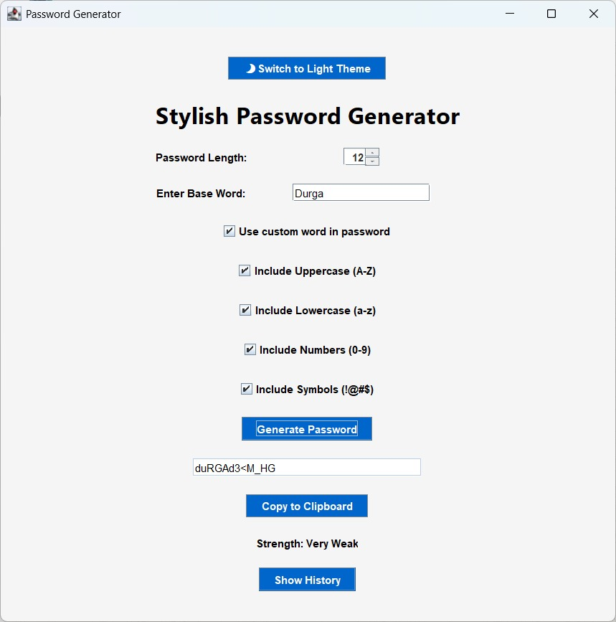
Theme Switcher

Slide 10


Slide 11


Slide 12


Slide 13


